Slide 1



Apache Flink-新一代流式处理框架
2017/06/05 & 上海博泰

Slide 2
Flink Content
Flink Introduction
Flink Architecture
DataStream Processing
Batch Processing
Table Processing
Complex Event Processing
Flink ML & Gelly
Distributed Runtime Environment

Slide 3
Introduction
支持高吞吐、低延迟、高性能的流处理
支持带有事件时间的窗口（Window）操作
支持有状态计算的Exactly-once语义
支持高度灵活的窗口（Window）操作，支持基于time、count、session，以及data-driven的窗口操作
支持具有Backpressure功能的持续流模型
支持基于轻量级分布式快照（Snapshot）实现的容错
一个运行时同时支持Batch on Streaming处理和Streaming处理
Flink在JVM内部实现了自己的内存管理
支持迭代计算
支持程序自动优化：避免特定情况下Shuffle、排序等昂贵操作，中间结果有必要进行缓存

Slide 4
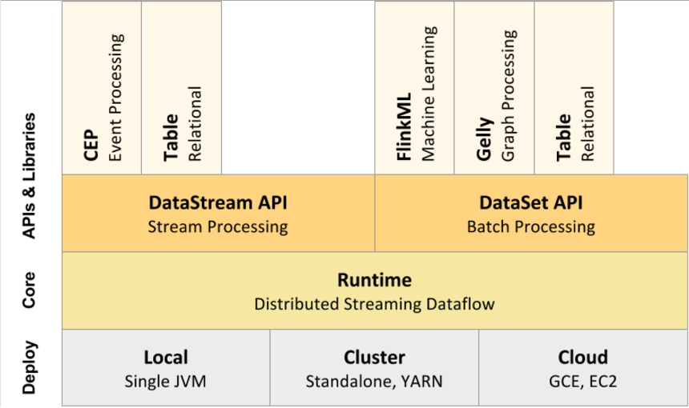
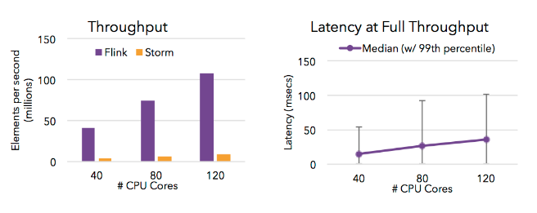
Architecture

Slide 5
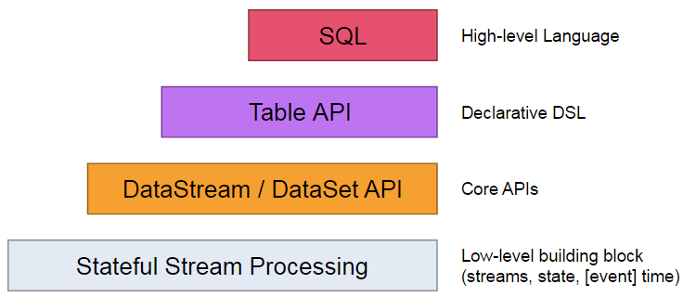
Levels of Abstraction
最低层次的抽象仅仅提供stateful streaming 。能够将数据转换成DataStream，允许用户使用一个或者多个streams数据，并且保证使用一致性容错，用户可是注册事件时间，并用回调函数，处理复杂的计算（当然大多数情况是不需要的）。
程序基于主要的API进行开发，比如 (bounded/unbounded streams) 以及(bounded data sets)。这些流式API提供transformations, joins, aggregations, windows, state, 等操作。这些数据的类型是作为class存在。
在TableAPI 表中数据会随着streams的改变。并且提供一些SQL类似的操作：select, project, join, group-by, aggregate以及自定义UDF并且进行优化器优化之后执行。TableAPI可以和DataStream and DataSet APIs进行无缝转换。
4. 支持SQL语句查询

Slide 6
DataStream API Programming Guide
1. DataStream Transformations
Data Sources
Data Sinks
Iterations
Execution Parameters
Fault Tolerance
Controlling Latency
Debugging

Slide 7
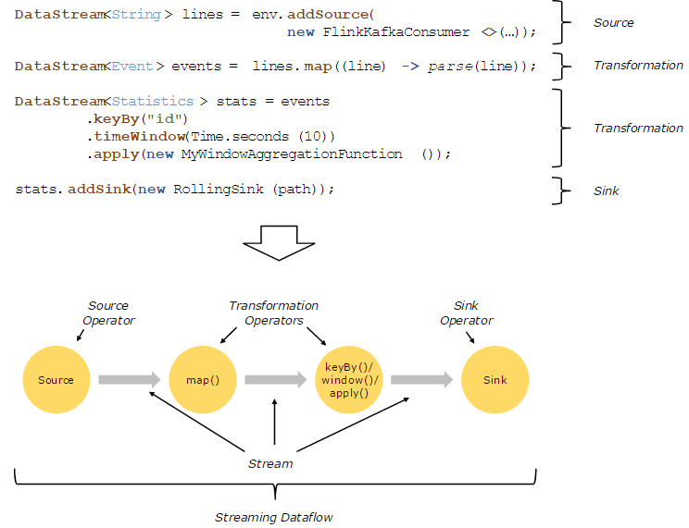
DataStream

Slide 8
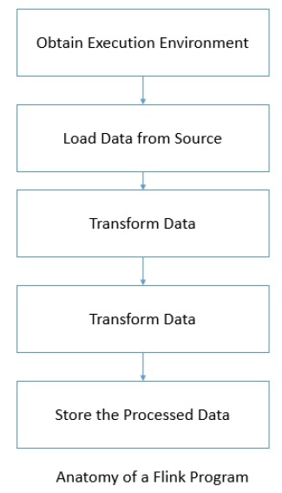
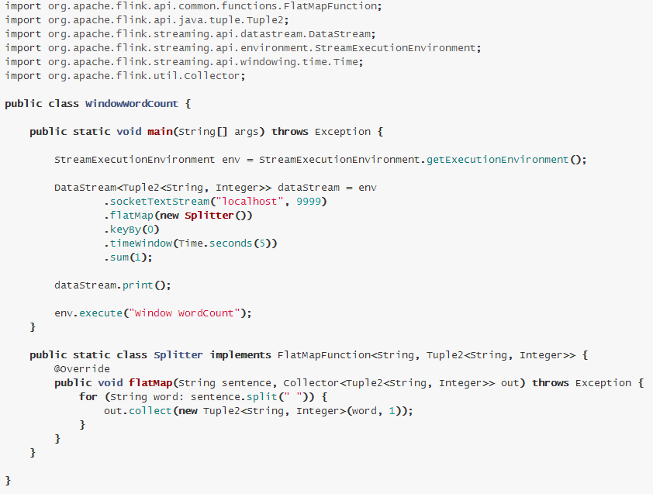
DataStream
1. Execution env
2. Data sources
3. Transformations
4. Data sinks
5. Connectors

Slide 9
DataStream Source/Transformation/Sink
Source:
Socket-based : socketTextStream(hostName, port)
File-based : readFileStream(String filePath, long intervalMillis, watchType)
Collection-based: fromCollection , fromElements, fromParallelCollection
Custom : addSource(new FlinkKafkaConsumer08<>())
You can also specify the exact offsets the consumer should start from for each partition
Transformation:
1. Map, FlatMap, Filter, KeyBy, Reduce, Aggregations, Window…
Sink:
Print : print()/ printToErr
Write: writeAsText (), writeAsCsv(), writeUsingOutputFormat(), writeToSocket
addSink: addSink (new FlinkKafkaProducer08<>())

Slide 10
DataStream Window
Keyed vs Non-Keyed Windows
1. Having a keyed stream will allow your windowed computation to be performed in parallel by multiple tasks, as each logical keyed stream can be processed independently from the rest.
2. In case of non-keyed streams, your original stream will not be split into multiple logical streams and all the windowing logic will be performed by a single task, i.e. with parallelism of 1.
Window Lifecycle：
In a nutshell, a window is created as soon as the first element that should belong to this window arrives, and the window is completely removed when the time (event or processing time) passes its end timestamp plus the user-specified allowed lateness.
Flink will create a new window for the interval between 12:00 and 12:05 when the first element with a timestamp that falls into this interval arrives, and it will remove it when the watermark passes the 12:06 timestamp.
Window have a Trigger, Function and Evictor.

Slide 11
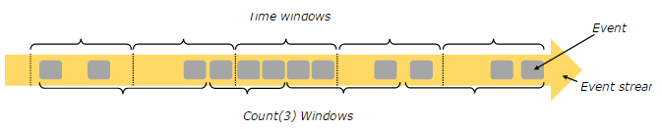
DataStream Window assigner
Feature:
基于时间驱动 example: every 30 seconds
基于数据驱动 example: every 100 elements
Window Types:
tumbling windows : 无重叠窗口
sliding windows : 可以重叠的滑动窗口
session windows : 会话窗口
global windows : 全局窗口

Slide 12
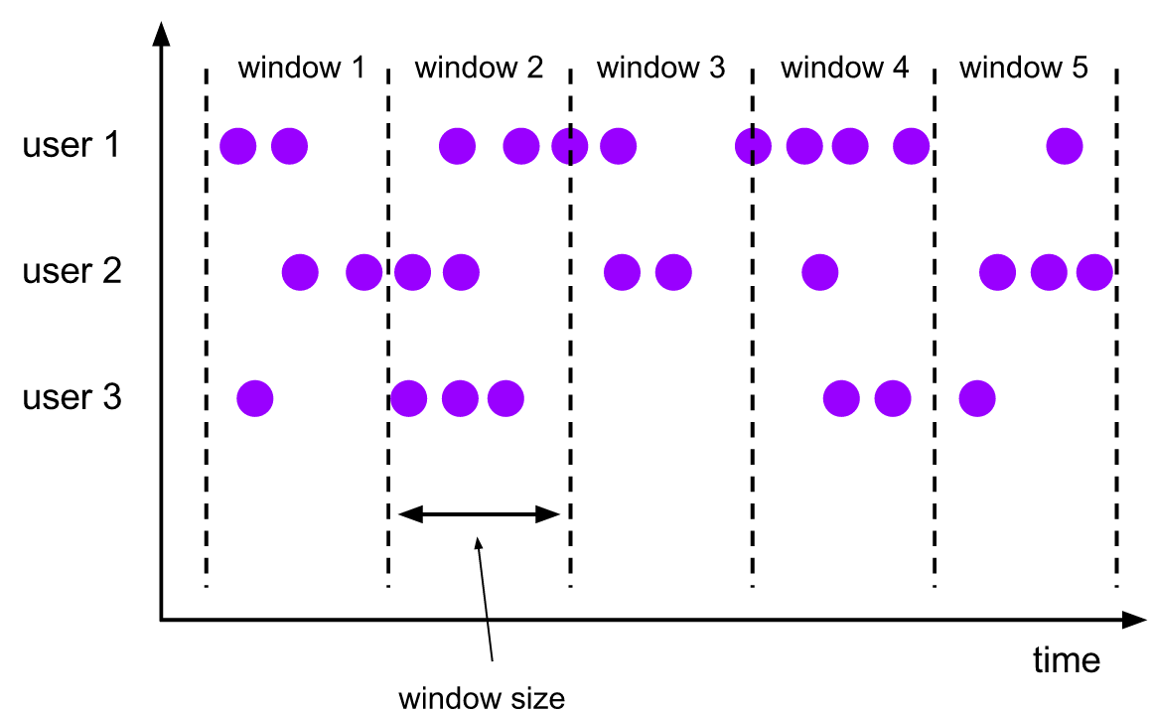
DataStream Window
tumbling windows

Slide 13
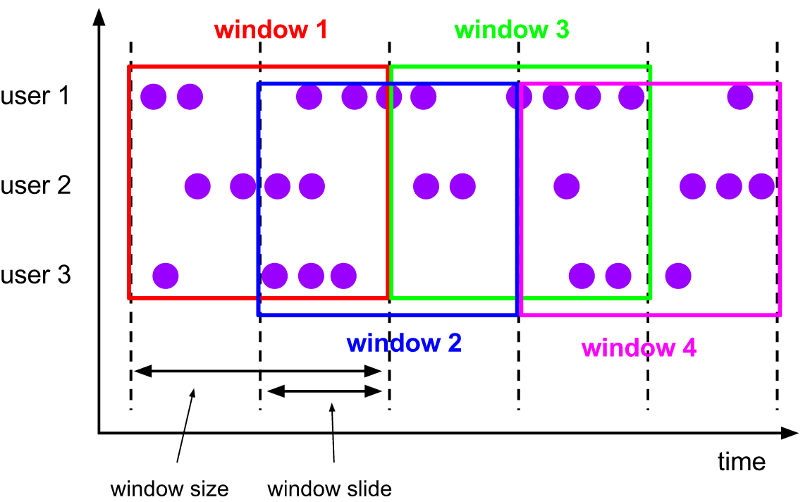
DataStream Window
sliding windows

Slide 14
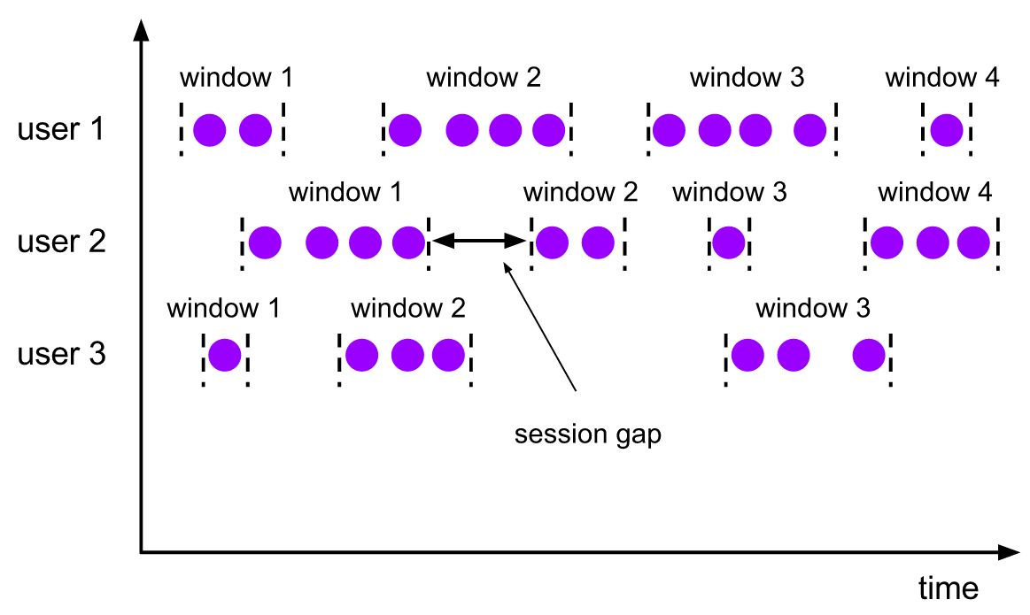
DataStream Window
会话超时窗口，窗口宽度取决于session gap
session windows

Slide 15
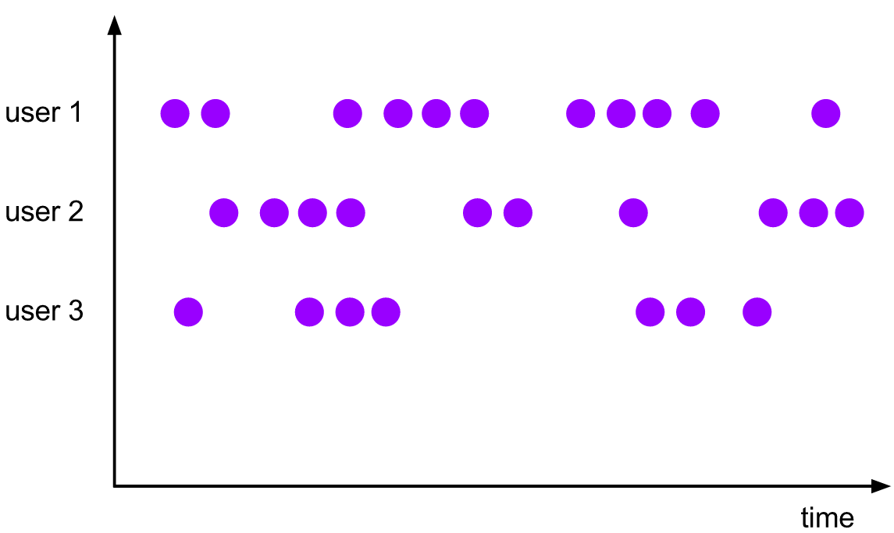
DataStream Window
global windows

Slide 16
Window Functions
ReduceFunction, FoldFunction : Flink can incrementally aggregate the elements for each window as they arrive.
WindowFunction:Flink has to buffer all elements for a window internally before invoking the function
ReduceFunction
DataStream<Tuple2<String, Long>> input = ...;
input
.keyBy(<key selector>)
.window(<window assigner>)
.reduce(new ReduceFunction<Tuple2<String, Long>> {
public Tuple2<String, Long> reduce(
Tuple2<String, Long> v1, Tuple2<String, Long> v2) {
return new Tuple2<>(v1.f0, v1.f1 + v2.f1);
}
});
FoldFunction
DataStream<Tuple2<String, Long>> input = ...;
input
.keyBy(<key selector>)
.window(<window assigner>)
.fold("", new FoldFunction<Tuple2<String, Long>, String>> {
public String fold(String acc, Tuple2<String, Long> value)
{
return acc + value.f1;
}
});
Window Function :Incremental Window Aggregation with FoldFunction/ReduceFunction
Notes:
Adasda
Asdas

Slide 17
Window Triggers
每个WindowAssigner 都有默认的Trigger：
Trigger提供了五中方法来处理不同的事件:
1. onElement() 窗口中的每个元素都会被执行.
2. onEventTime()当注册的事件触发器触发
3. onProcessingTime() 当注册的时间触发器触发
4. onMerge() 针对于有状态的Trigger，当相对应的window merge的时候合并两者的状态，比如session window
5. clear()当对应的窗口需要执行移除操作的时候
注意:
1.前三种决定了怎么处理对应的触发事件，并返回一个TriggerResult：
CONTINUE: 什么也不做
FIRE: 触发计算
PURGE: 清除窗口的元素
FIRE_AND_PURGE: 触发计算然后清除元素
2.任何一种方法都能被注册为时间或者事件触发器

Slide 18
Window Evictors
The evictor has the ability to remove elements from a window after the trigger fires and before and/or after the window function is applied
//Optionally evicts elements. Called before windowing function.
void evictBefore(Iterable<TimestampedValue<T>> elements, int size, W window, EvictorContext evictorContext);
//Optionally evicts elements. Called after windowing function.
void evictAfter(Iterable<TimestampedValue<T>> elements, int size, W window, EvictorContext evictorContext);
注意点：
evictor阻止任何的pre-aggregation，因为元素在计算之前必须传递到evictor函数
window的数据不能保证数据的顺序，evictor同样也不保证窗口开始数据的顺序

Slide 19
Window Triggers
每个WindowAssigner 都有默认的Trigger：
Trigger提供了五中方法来处理不同的事件:
1. onElement() 窗口中的每个元素都会被执行.
2. onEventTime()当注册的事件触发器触发
3. onProcessingTime() 当注册的时间触发器触发
4. onMerge() 针对于有状态的Trigger，当相对应的window merge的时候合并两者的状态，比如session window
5. clear()当对应的窗口需要执行移除操作的时候
注意:
1.前三种决定了怎么处理对应的触发事件，并返回一个TriggerResult：
CONTINUE: 什么也不做
FIRE: 触发计算
PURGE: 清除窗口的元素
FIRE_AND_PURGE: 触发计算然后清除元素
2.任何一种方法都能被注册为时间或者事件触发器

Slide 20
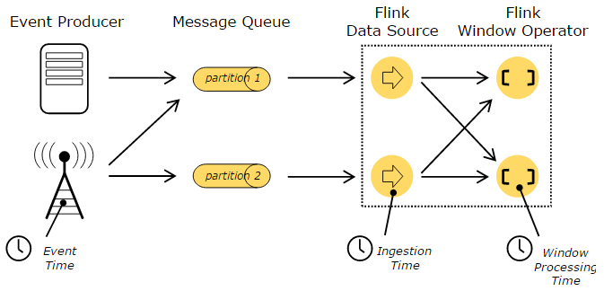
Window Time
Event Time: Event time is the time that each individual event occurred on its producing device. 时间产生的时间点,能够保证无序的数据或者是延迟的数据以及失败后的从备份或者持久化的文件恢复时得到正确的结果。通常需要结合process time使用，需要手动指定如何获取event time 以及watermark。
Ingestion time: Flink source operator接收到消息的时间点，不能处理任何无序事件数据,但这些项目没有指定如何生成水印。
Processing Time:每个operator执行一个基于时间操作的时间点

Slide 21
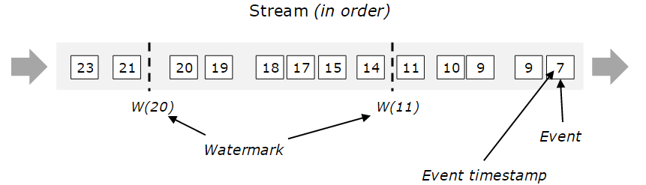
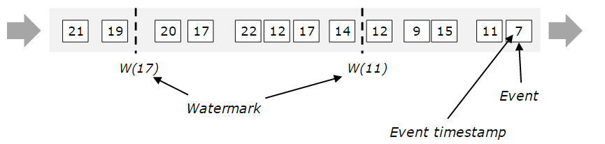
Window Event Time and Watermarks
图片的理解：watermark就是一个时间印记，记录已经来的抵达事件中的数据的时间戳的最大值
来标识已经收到数据的时间，在operator操作中更新该标识。
Notes:
图片的理解：watermark就是一个时间印记，记录已经来的抵达事件中的数据的时间戳的最大值来标识已经收到数据的时间，在operator操作中更新该标识。

Slide 22
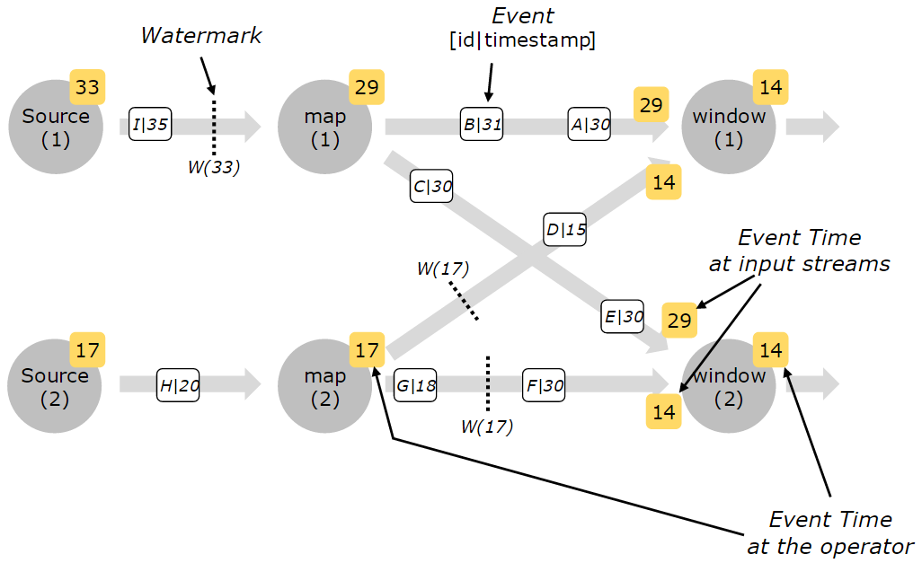
Window Event Time and Watermarks
Notes:
Each parallel subtask of a source function usually generates its watermarks independently.
As the watermarks flow through the streaming program, they advance the event time at the operators where they arrive. Whenever an operator advances its event time, it generates a new watermark downstream for its successor operators.
Such an operator’s current event time is the minimum of its input streams’ event times. As its input streams update their event times, so does the operator.

Slide 23
Window Allowed Lateness
Late elements are dropped when the watermark is past the end of the window.
Allowed lateness specifies by how much time elements can be late before they are dropped, and its default value is 0.
Elements that arrive after the watermark has passed the end of the window but before it passes the end of the window
plus the allowed lateness, are still added to the window.
DataStream<T> input = ...;
input
.keyBy(<key selector>)
.window(<window assigner>)
.allowedLateness(<time>)
.<windowed transformation>(<window function>);
Late elements considerations
These firings are called late firings, as they are triggered by late events and in contrast to the main firing which is the first firing of the window.
In case of session windows, late firings can further lead to merging of windows, as they may “bridge” the gap between two pre-existing, unmerged windows.
Attention:
Depending on your application, you need to take these duplicated results into account or deduplicate them.
Notes:
Each parallel subtask of a source function usually generates its watermarks independently.
As the watermarks flow through the streaming program, they advance the event time at the operators where they arrive. Whenever an operator advances its event time, it generates a new watermark downstream for its successor operators.
Such an operator’s current event time is the minimum of its input streams’ event times. As its input streams update their event times, so does the operator.

Slide 24
Window Generating Timestamps/Watermarks
两种方式产生 timestamps and generate watermarks:
1. 直接在数据源中指定
2. 通过 timestamp assigner / watermark generator:在flink中指定了 timestamp 也就决定了watermarks的产生
@Override
public void run(SourceContext<MyType> ctx) throws Exception {
while (/* condition */) {
MyType next = getNext();
ctx.collectWithTimestamp(next, next.getEventTimestamp());
if (next.hasWatermarkTime()) {
ctx.emitWatermark(new Watermark(next.getWatermarkTime()));
}
}
}
Notes:
Each parallel subtask of a source function usually generates its watermarks independently.
As the watermarks flow through the streaming program, they advance the event time at the operators where they arrive. Whenever an operator advances its event time, it generates a new watermark downstream for its successor operators.
Such an operator’s current event time is the minimum of its input streams’ event times. As its input streams update their event times, so does the operator.

Slide 25
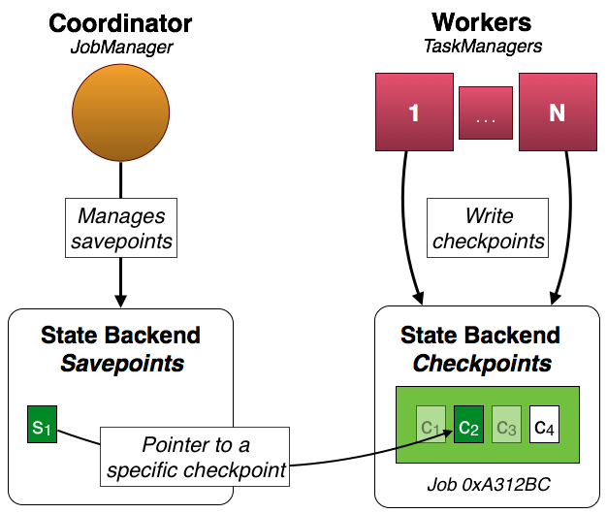
Window Savepoints
Notes:
Each parallel subtask of a source function usually generates its watermarks independently.
As the watermarks flow through the streaming program, they advance the event time at the operators where they arrive. Whenever an operator advances its event time, it generates a new watermark downstream for its successor operators.
Such an operator’s current event time is the minimum of its input streams’ event times. As its input streams update their event times, so does the operator.

Slide 26
THANK YOU

